Slide 1
Generating Power for Remote Applications in Extreme Environments
Nathan Rich
Supervisor: Pat Bodger
Acknowledgements: Bill Heffernan and Alan Wood

Slide 2
Aim
This project intends to find a novel way of powering a device without the use of battery power

Slide 3
Specific Aims
Investigate an extreme environment
Find a suitable way to power a device and design a solution
The goal upon completion is to have a well thought out design that could be built and used in the real world

Slide 4
Extreme Environment: The Sea
The sea cover approximately ¾ of the earths surface
Relatively unexplored due to harsh environment: Temperatures, pressures, no oxygen
A robot could be used
If no batteries then it could stay underwater for indefinite periods!

Slide 5
Method Power Generation
Pressure: requires a differential that is not easily obtained
Temperature: requires a differential that is not easily obtained
Chemical: all chemicals in the water are in a post-reacted state
Kinetic: Could use undersea currents with a turbine..

Slide 6
Specification
A robot that is able to move under its own power while:
Withstanding temperatures: 3 - 21 ̊C
Withstanding pressures: 1 atmosphere for every 10m underwater
Withstanding corrosion from salt water

Slide 7
Simplifications
No turning functionality
No control ie. goes forward when has power, idle otherwise
These things to be added after initial design proven

Slide 8
Theory of Operation

Slide 9
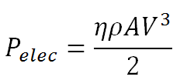
Turbine
Size of turbine determines the power available:
Robot will require 25W of power including power loss to power converter inefficiency
Diameter of turbine is 23.8 cm

Slide 10
Generator & Motor
Generator chosen is Scorpion S-4025-16
Motor chosen as RE-540 Como Drills motor
Motor running characteristics are 5V, 1A, 0.72Ω internal resistance
Chosen not for efficiency, instead for cost as already in department

Slide 11
Undersea Challenges
To stop water from getting in, it must be water tight but to stop the pressure from crushing it, the robot must be filled with a non-compressible, non-conducting liquid, a good choice is therefore oil.
To avoid rust the exterior of the robot will be made from plastic
Tank tracks will be used to give maximum traction and to spread weight to stop sinking occurring in the soft sediment

Slide 12
Testing – Generator

Slide 13
Single Phase Equivalent
R = 0.034 Ω
L = 0.000478 H
E

Slide 14
Generator Test Results
Maximum Power Output at 0.5Ω = 70W
Speed required for 25W = 2400rpm
Voltage given at 2400rpm = 4.7 V
Current given at 2400 rpm = 5.4 A

Slide 15
Gearbox
A gearbox will be required to bring the turbine up to speed in order to generate efficiently
Speed required is 2400 rpm
Speed of turbine when water flow is 1.54 ms⁻¹ is estimated to be 124 rpm
Therefore gearbox ratio is 19:1

Slide 16
Output Motors
Want to take resistance seen by the generator down to increase power output
Therefore parallel two motors to decrease resistance to 0.36Ω and to give 4WD

Slide 17
Power Converter
Must convert from 4.7 Vrms, 5.4 Arms to 5V, 2A DC
Use a three phase rectifier bridge, small amount of DC to stabilize the wave bus capacitance and a buck-boost converter to regulate the voltage

Slide 18
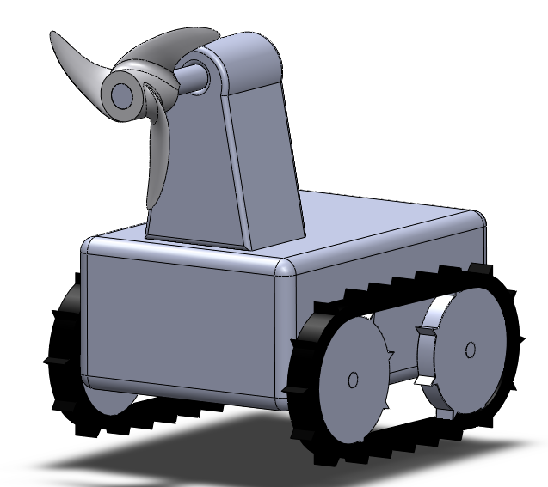
Design Concept

Slide 19
Cost
Item | Cost
Generator | $180
Motor (x2) | $51
Turbine | $25
Tank tracks and wheels | $50
Enclosure | $50
Oil | $10
Total | $366

Slide 20
Future Steps
Build tank tracks and use with motors to find exact characteristics
Choose and purchase power converter
Slowly build and test
Final test in water tunnel with current coming through

Slide 21
Conclusions
Project was a success
Design completed
Future work allowed for
Plastic components to resist corrosion
Oil filled to resist pressure

Slide 22
Questions?

